Slide 1
PImage TowerPic;
int W,
H;
int N;
void setup() {
TowerPic = loadImage("Tower.jpg");
W = 2 * TowerPic.width;
H = TowerPic.height;
size(W, H);
width = W;
height = H;
image(TowerPic, 0, 0);
save("TP0.jpg");
}
boolean Q_Show = false;
void draw() {
int i;
int T = 100000;
int x,
y;
if(Q_Show) {
loadPixels();
N = pixels.length;
for(i = 0; i < T; i++) {
x = int(random(W/2));
y = int(random(H));
pixels[W - x - 1 + y * W] = TowerPic.get(x, y);
}
}
}
void mousePressed() {
Q_Show = true;
}
int PNum = 1;
void keyPressed() {
updatePixels();
save("TP" + PNum + ".jpg");
PNum++;;
}
Code For Exam Question 4
4
(a)Make a rough sketch of the top left image from the Images For Exam Question 4 sheet
(i) Explain the result of executing each of the lines below , using your sketch where useful
1, 6, 12, 13
(ii)Explain the result of executing each of the lines , using your sketch where useful
2, 3, 4, 7, 8, 9, 10, 11
(b)
Explain the initial effect of line 15 on the draw() method
What is the effect of pressing the mouse on the draw() method?
(c)
(i) What is the effect of line 23 and 24?
What is the effect of lines 26, 27 and 28?
(d)
What is the effect of lines 35, 37, 38 and 39?
A key was pressed 7 times in the course of the execution of this programme. Summarise the overall effect of this programme in terms of pixels and positions on the canvas.

Slide 2
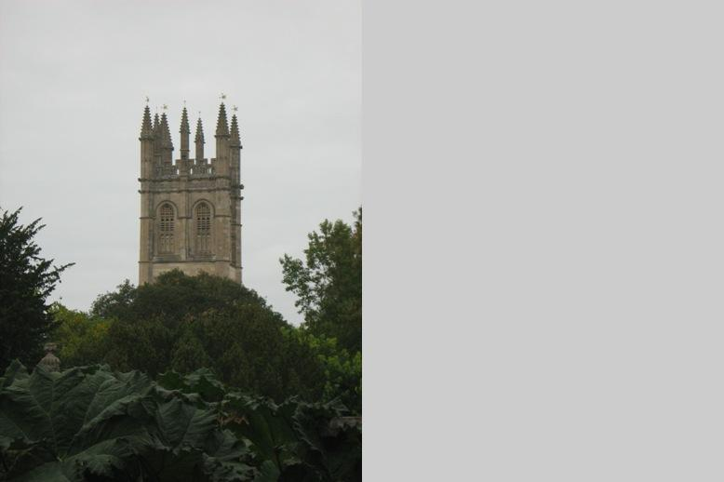
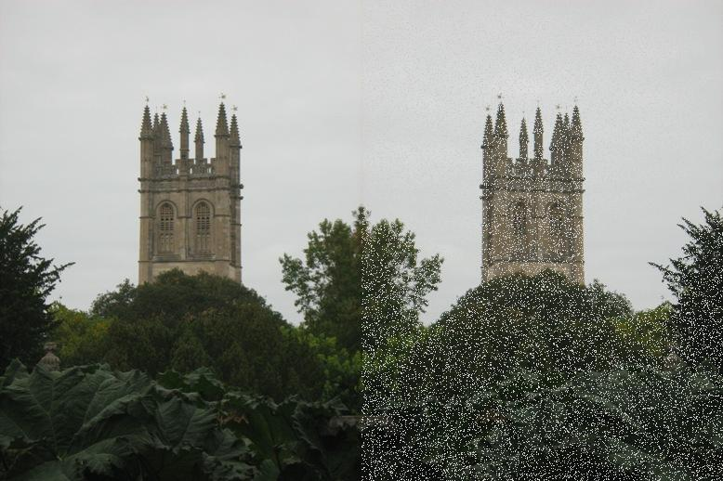
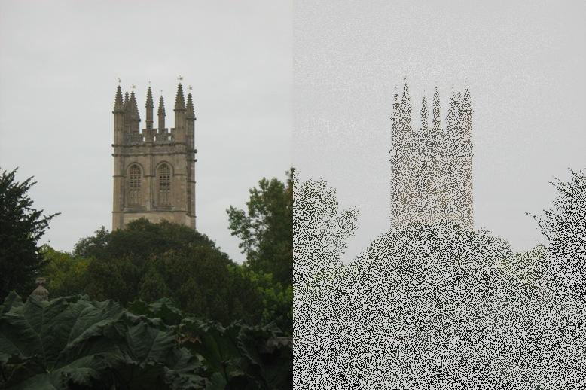
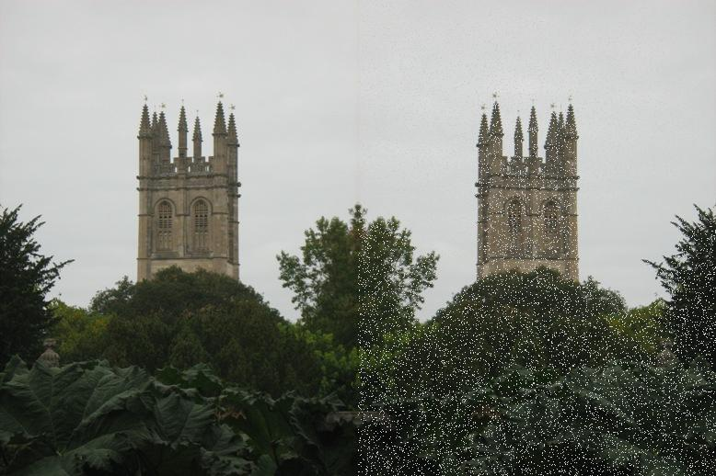
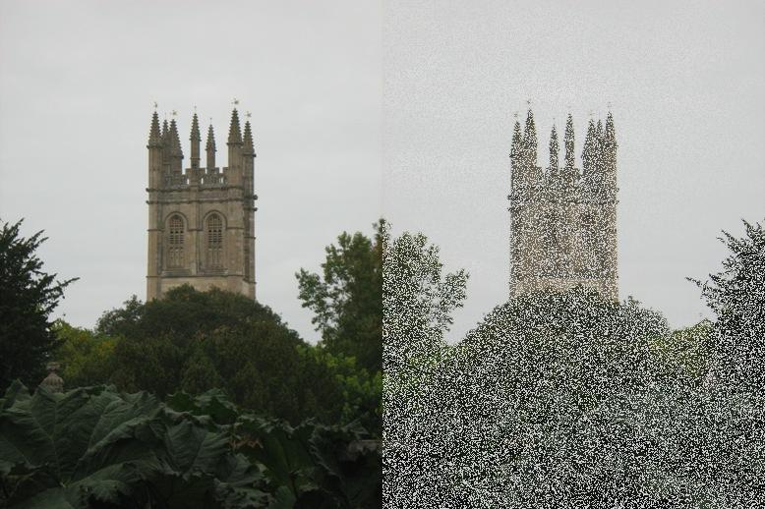
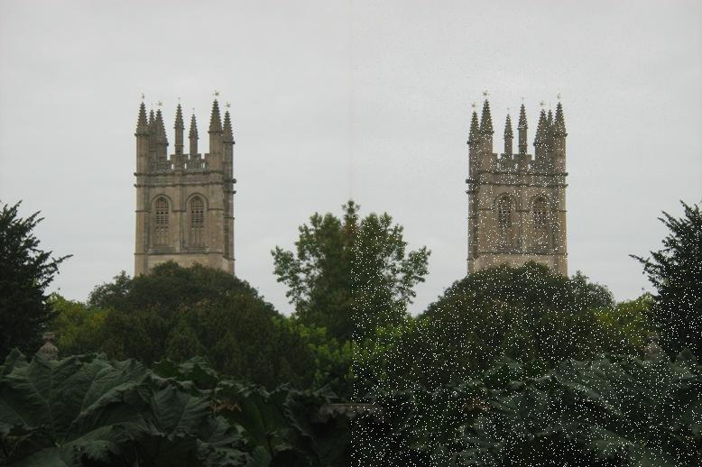
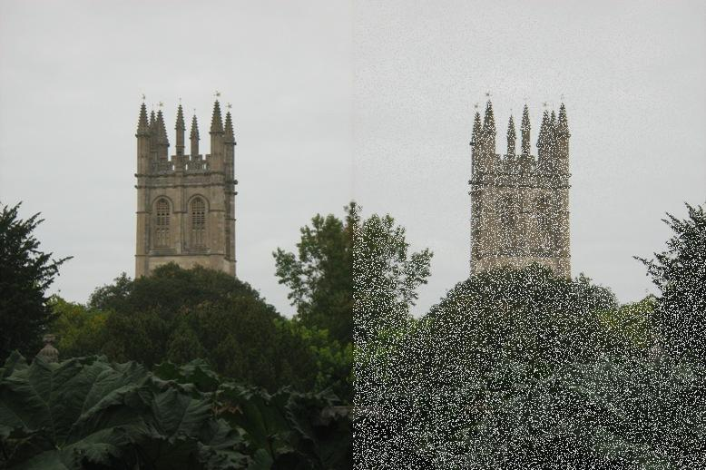
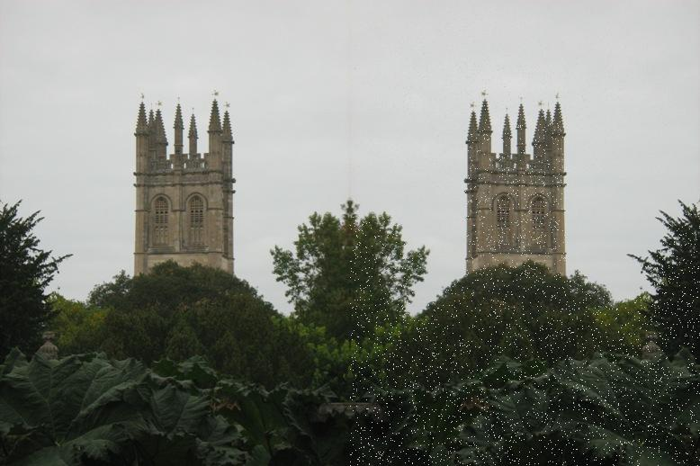
Images For Exam Question 4

